Slide 1
COVID-19 Global Data Tracker
By Malehek Yik Bol

Slide 2
Data Collection
I downloaded the 'owid-covid-data.csv' dataset from the World in Data website.

Slide 3
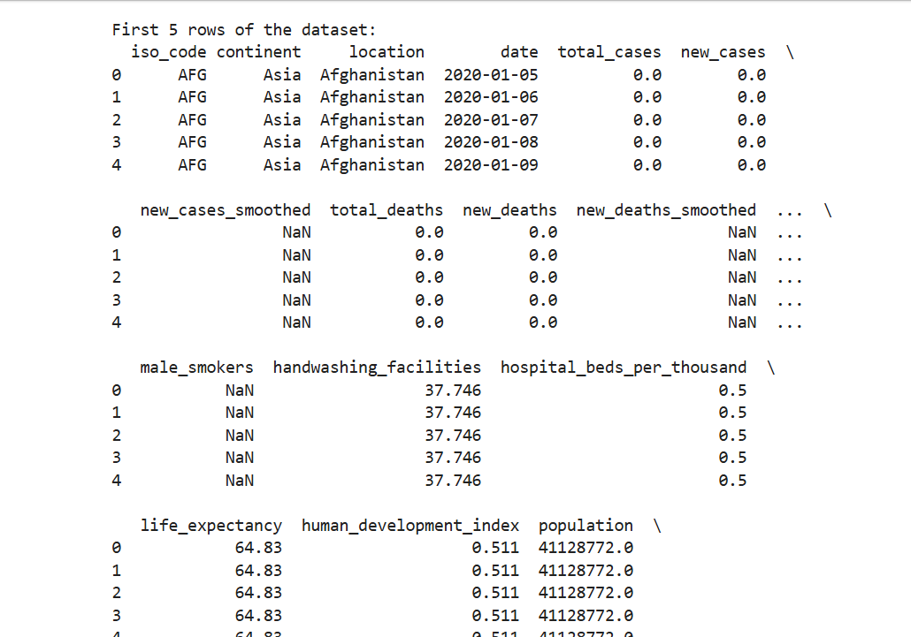
Data Loading & Exploration
I used pandas to load the dataset with `read_csv()`. Explore the dataset structure using `df.columns`, `df.head()`, and `df.isnull().sum()`.

Slide 4
Data Cleaning
I filtered countries of interest, dropped rows with missing critical values, converted the date column to datetime, and handled missing numeric values using `fillna()`.

Slide 5
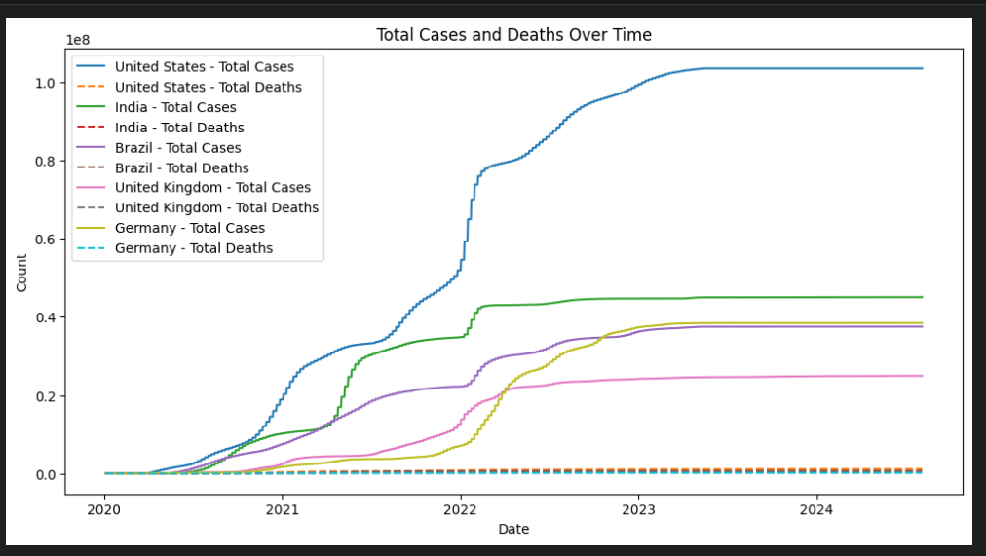
Exploratory Data Analysis (EDA)

Slide 6
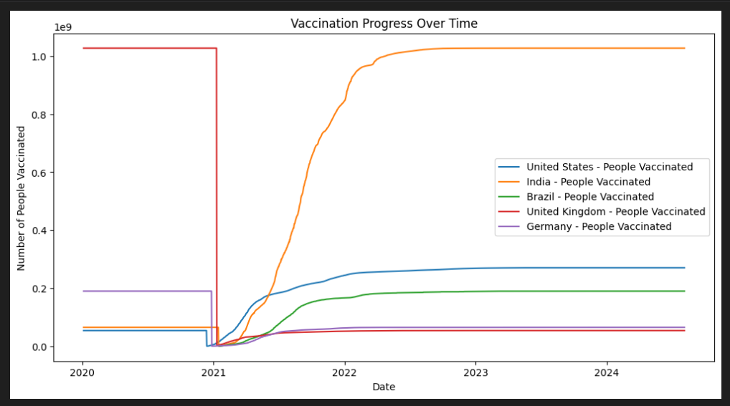
Visualizing Vaccination Progress

Slide 7
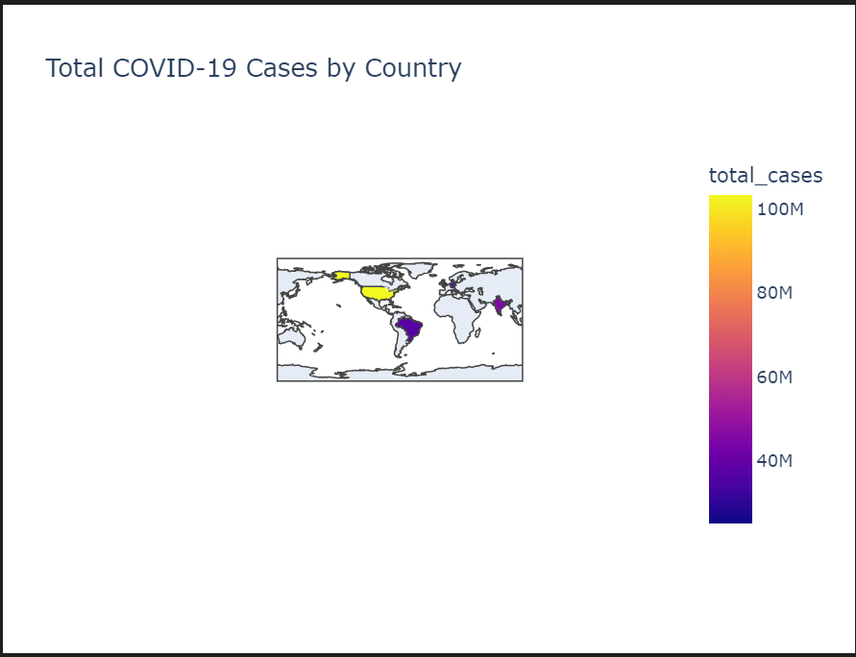
Choropleth Map

